Slide 1

SIGN LANGUAGE CONVERSION INTO TEXT
Under The Guidance of :
Dr. Raju N
By
126004121-Karthick Raja B
126004208-Ramana Guhan
126004041-Avinash

Slide 2
PROBLEM STATEMENT
Communication is the process of exchange of thoughts and messages in various ways such as speech, signals, behavior and visuals.
Deaf and dumb people make use of their hands to express different gestures to express their ideas with other people.
They cannot use spoken languages hence the only way for them to communicate is through sign language.

Slide 3
LITERATURE SURVEY
TITLE | INFERENCE
Conversion of sign language into text | Sign to text translation is achieved by pre-processing and hand segmentation , feature extraction , sign recognition and sign to text using MATLAB software.
Sign language into speech conversion and text | Conversion of sign language to text was achieved by FRCNN( Faster Convolutional Neural Networks),YOLO(You Only Look Once) and Mediapipe.
Real time conversion of sign language to text and speech , viceversa | Using CNN ( Convolutional Neural Network) ,image processing , animation gesture recognition to achieve accurate and efficient translation between sign language and spoken language.

Slide 4
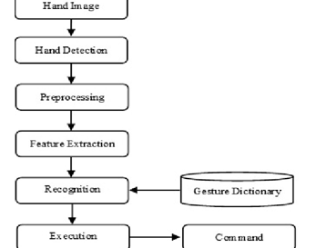
METHODOLOGY
Data Acquisition
Preprocessing
Feature Extraction
Gesture Recognition
Sign Language to Text Mapping
Display and Output

Slide 5
WORK CARRIED OUT
Data pre-processing and Feature extraction:
In this approach for hand detection, firstly we detect hand from image that is acquired by webcam .
For detecting a hand, we used media pipe library which is used for image processing. So, after finding the hand from image we get the region of interest. Then we cropped that image and convert the image to gray image using OpenCV library after we applied the gaussian blur.
The filter can be easily applied using open computer vision library also known as OpenCV. We have collected images of different signs of different angles for sign letter A to Z.

Slide 6
Continuation…..
We detect hand from frame using media pipe and get the hand landmarks of hand present in that image then we draw and connect those landmarks in simple white image.
Now we get this landmark points and draw it in plain white background using OpenCV library.
By doing this we tackle the situation of background and lightning conditions because the media pipe library will give us landmark points in any background and mostly in any lightning conditions.
Media pipe library files can detect 21 co-ordinates points present in our hand.

Slide 7
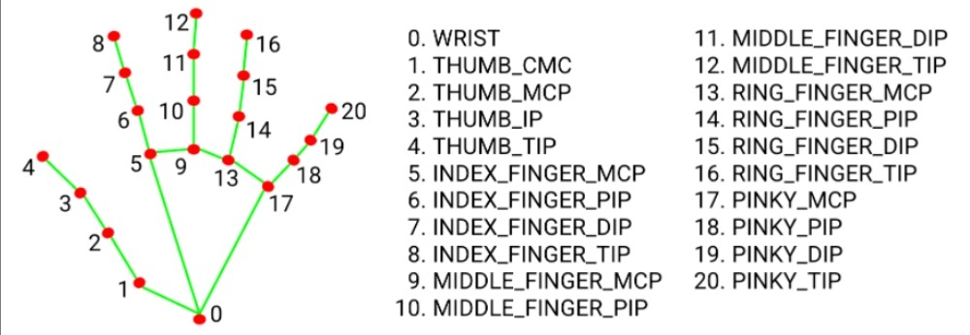
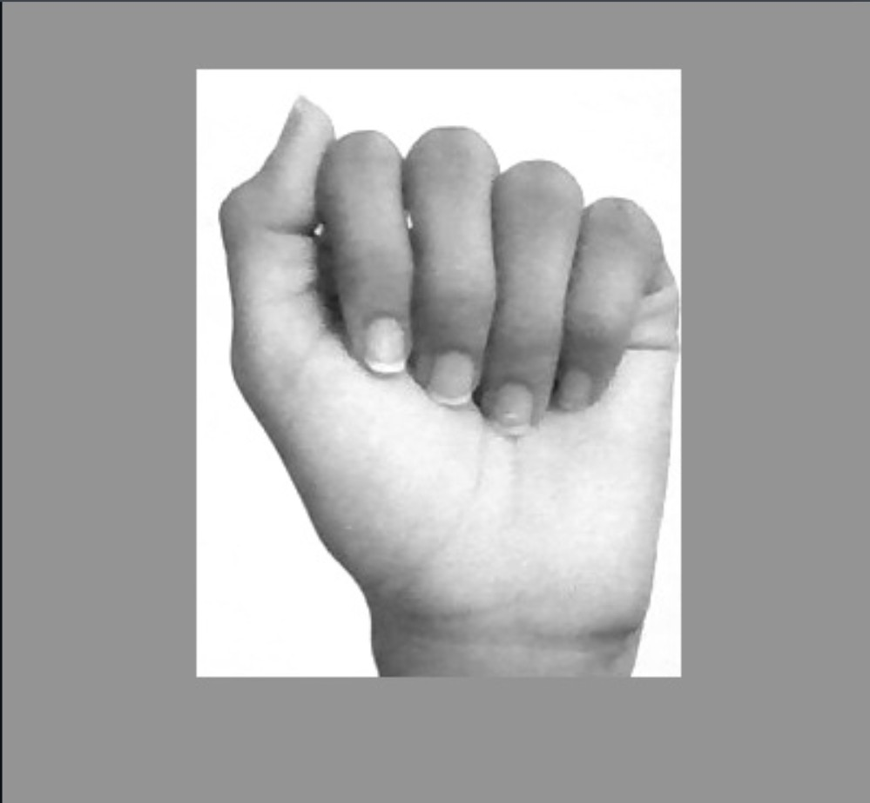

MEDIAPIPE CO-ORDINATES

Slide 8
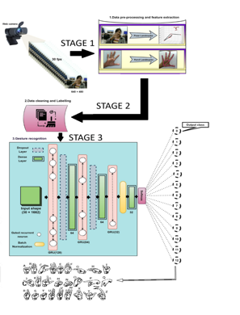
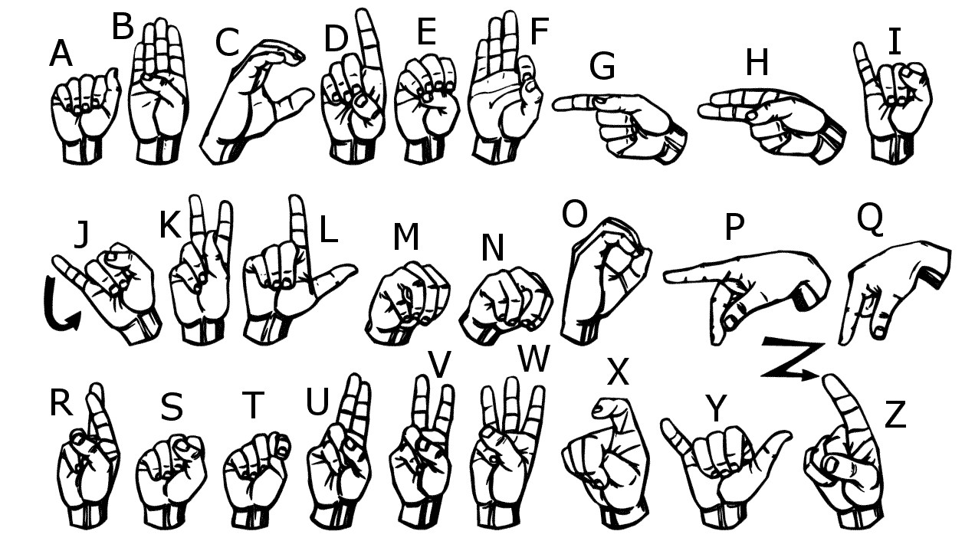
WORK PLAN

Slide 9
TIMELINE
REVIEW | PLAN
0th Review | Identification of problem statement and exploring the components required.
1st Review | Hand gesture capture, Image processing and Feature processing.
2nd Review | Based on the matched gesture, the corresponding word would be displayed as text.

Slide 10
REFERENCES
Anuja V.Nair, Bindu, “A Review on Indian Sign Language Recognition”, International journal of computer applications, Vol. 73, pp: 22, (2013).
Archana S. Ghotkar, Rucha Khatal, Sanjana Khupase, Surbhi Asati & Mithila Hadap, “Hand Gesture Recognition for Indian Sign Language”, IEEE International Conference on Computer Communication and Informatics (lCCCI ), pp: 1-4, (2012).
Hu Peng, “Application Research on Face Detection Technology based on Open CV in Mobile Augmented Reality”, International Journal of Signal Processing, Image Processing Recognition, Vol. 8, No. 2 (2015). and Pattern Recognition, Vol.8. No.2 (2015)

Slide 11


